Slide 1
TECHNOLOGY TRANSFER

Slide 2
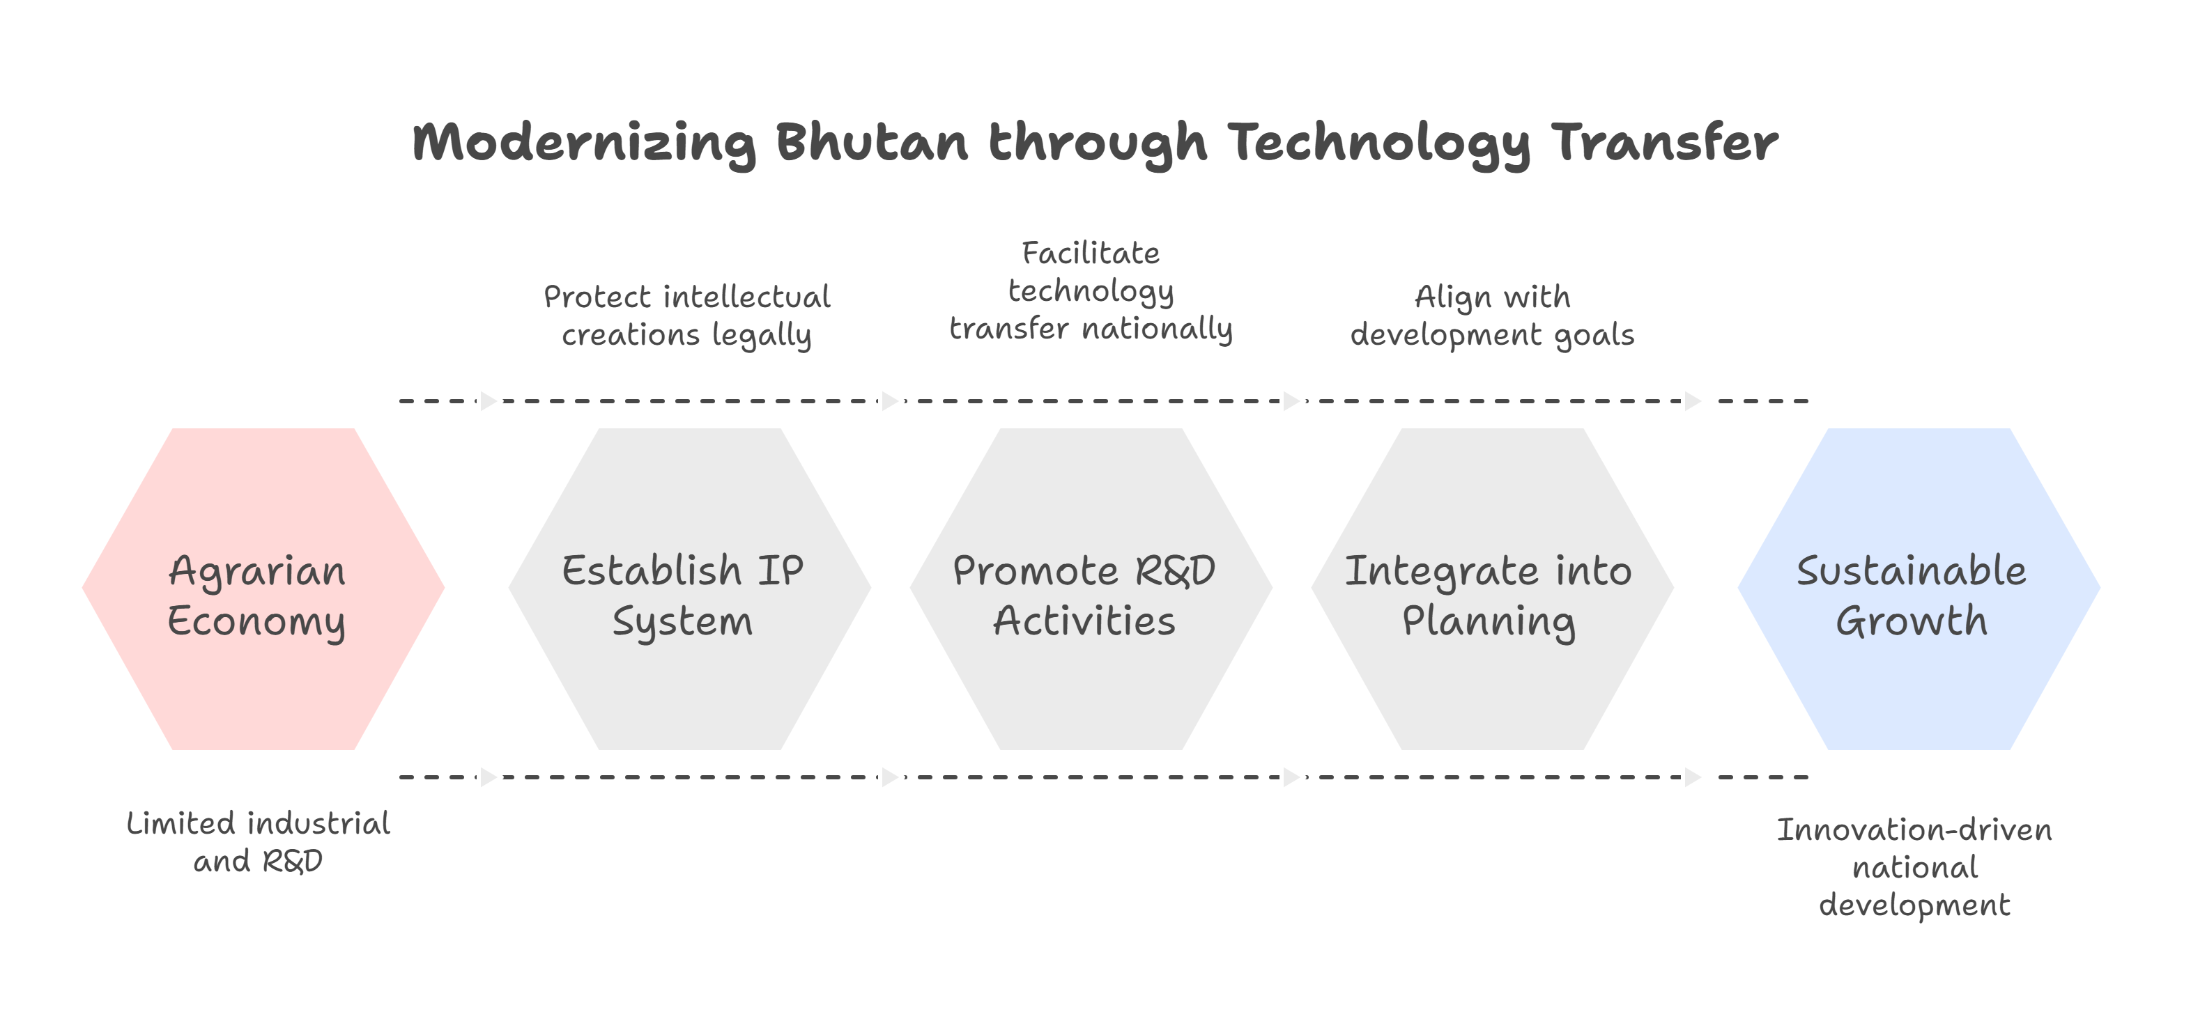

Slide 3


Slide 4


Slide 5
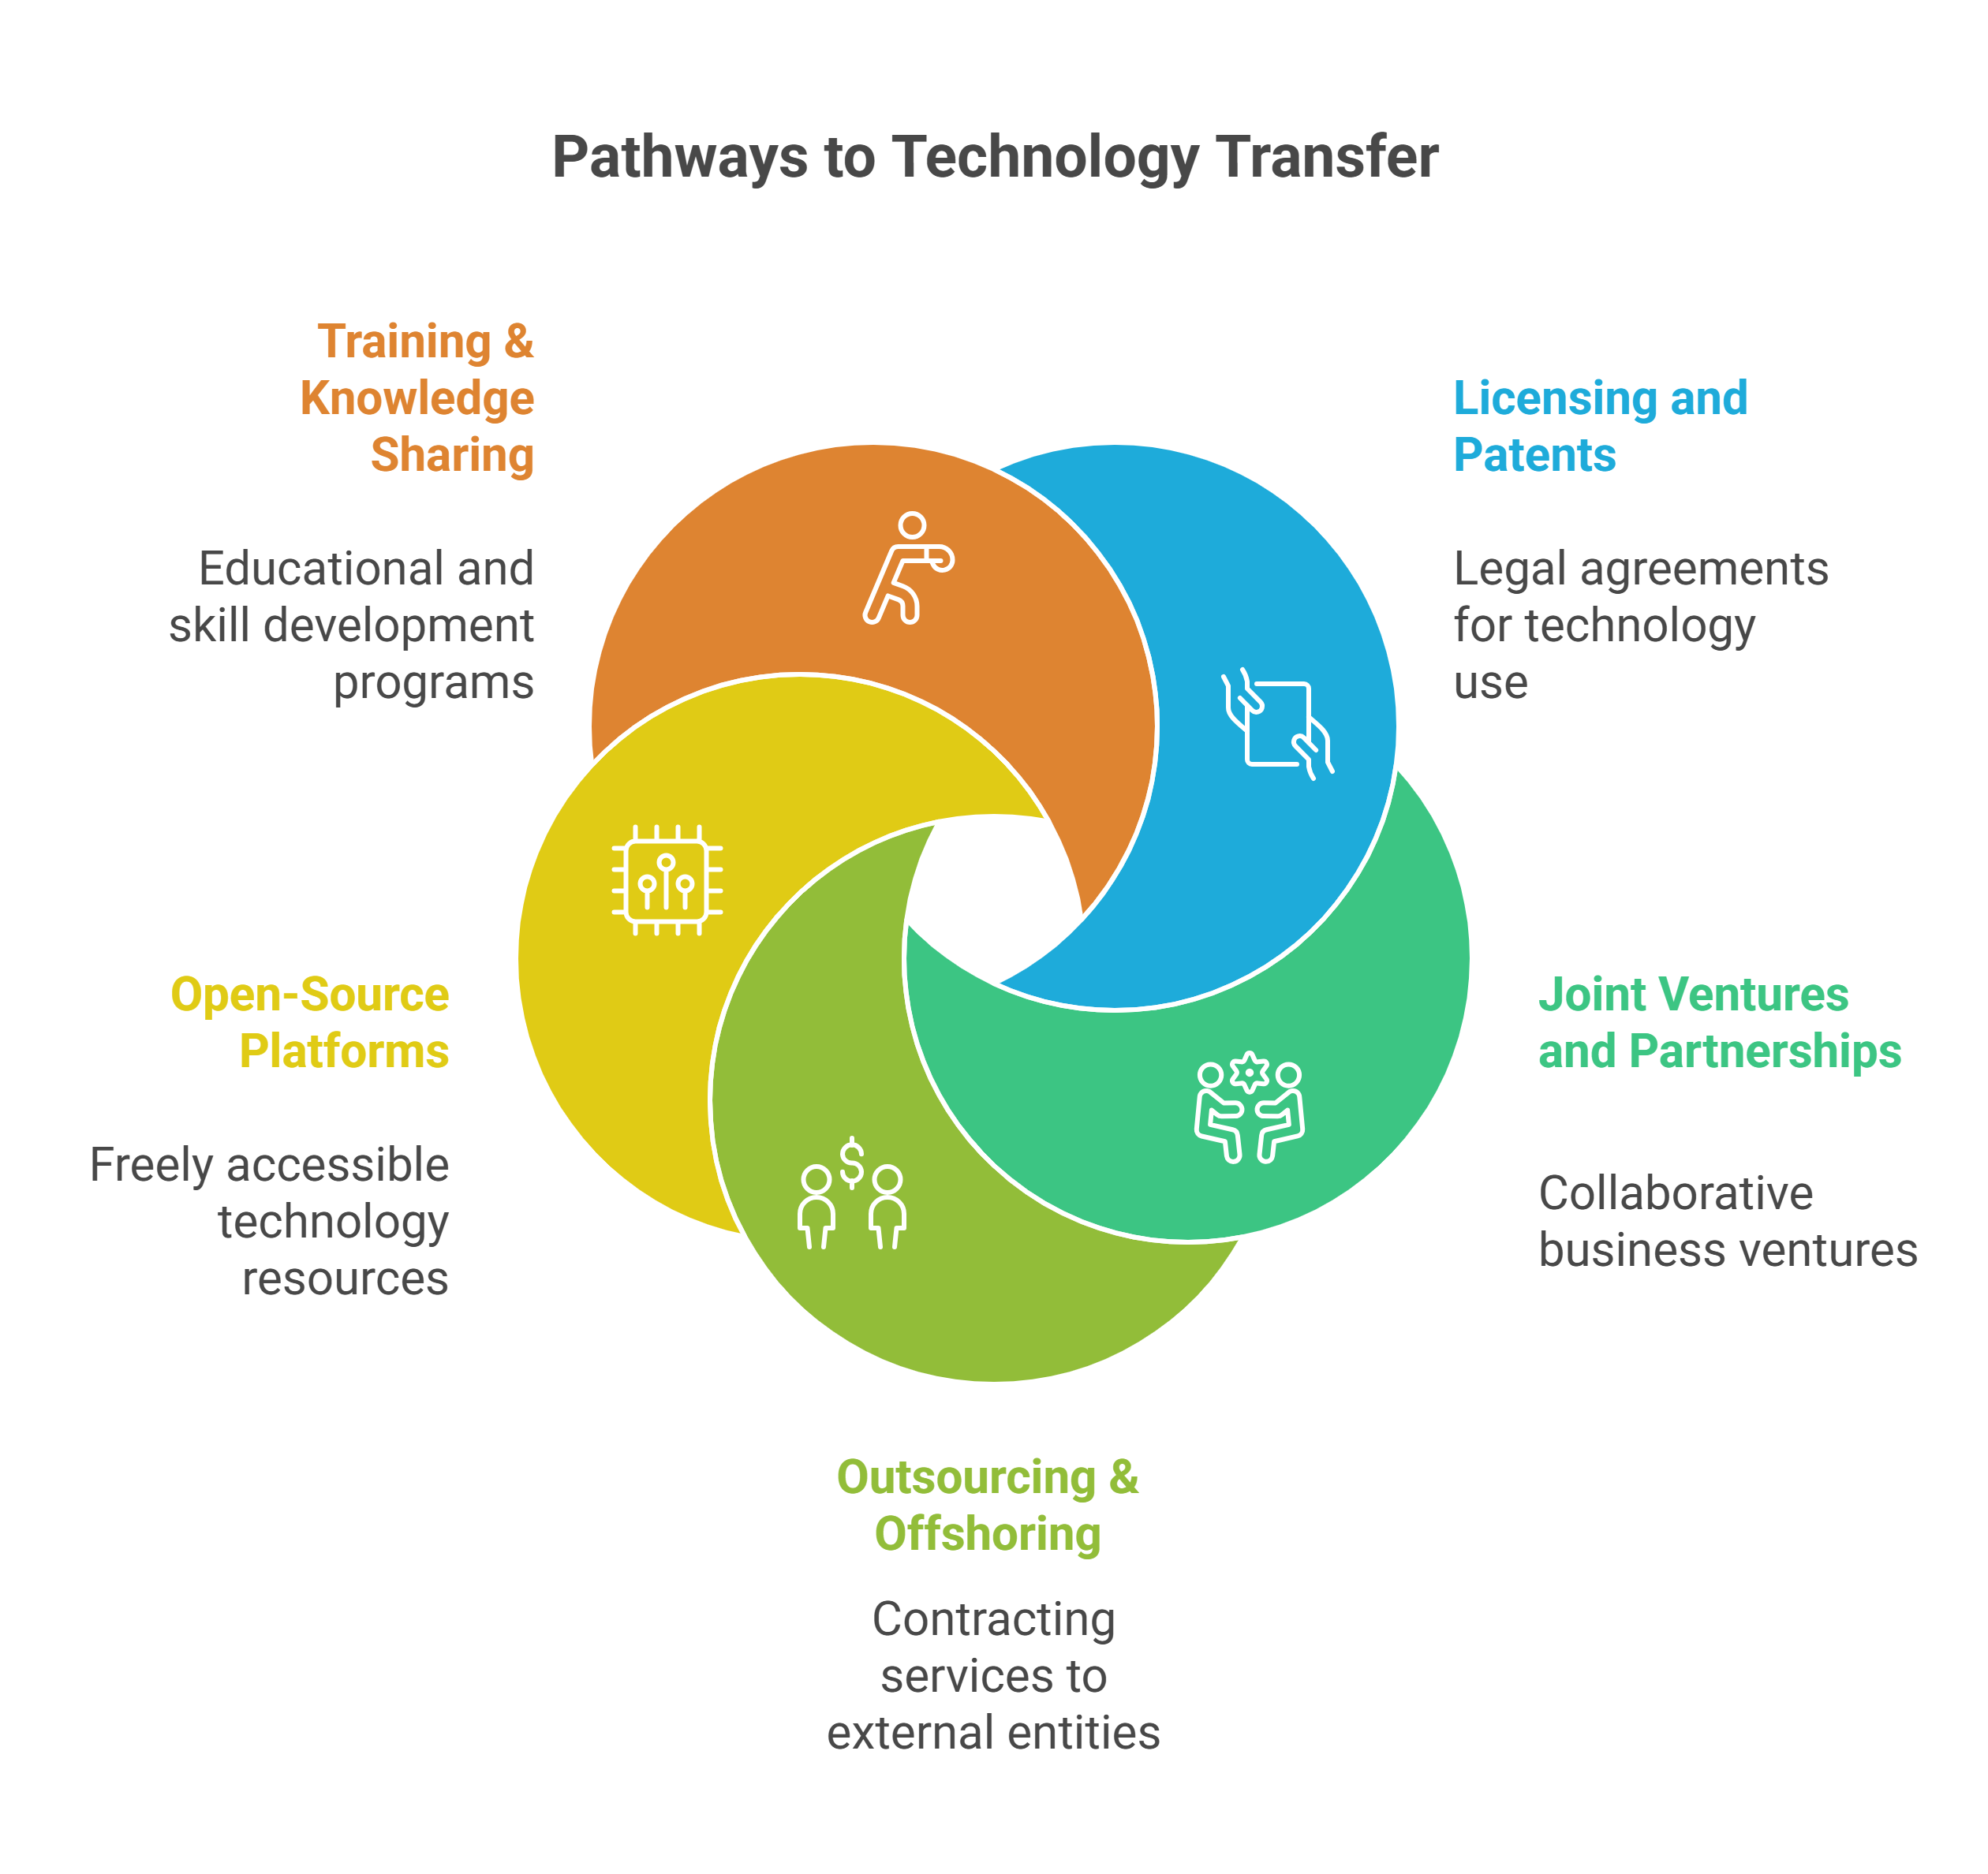

Slide 6
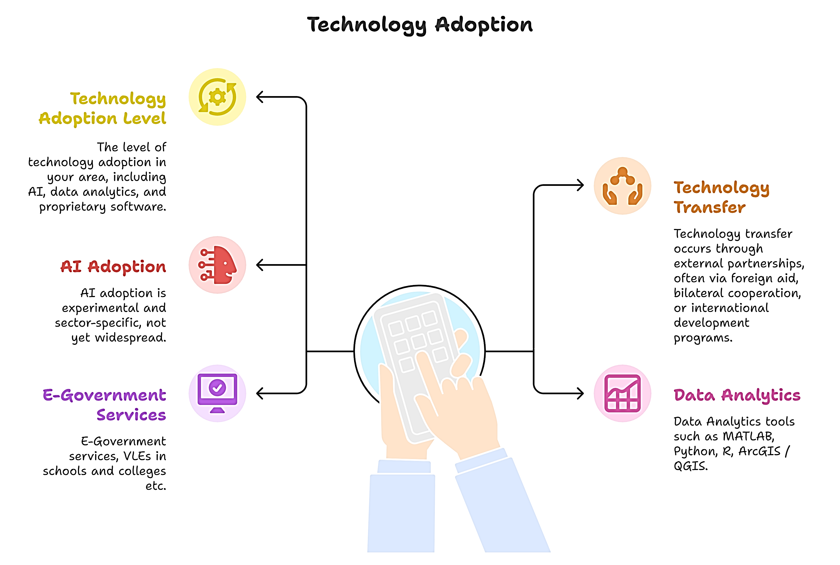

Slide 7
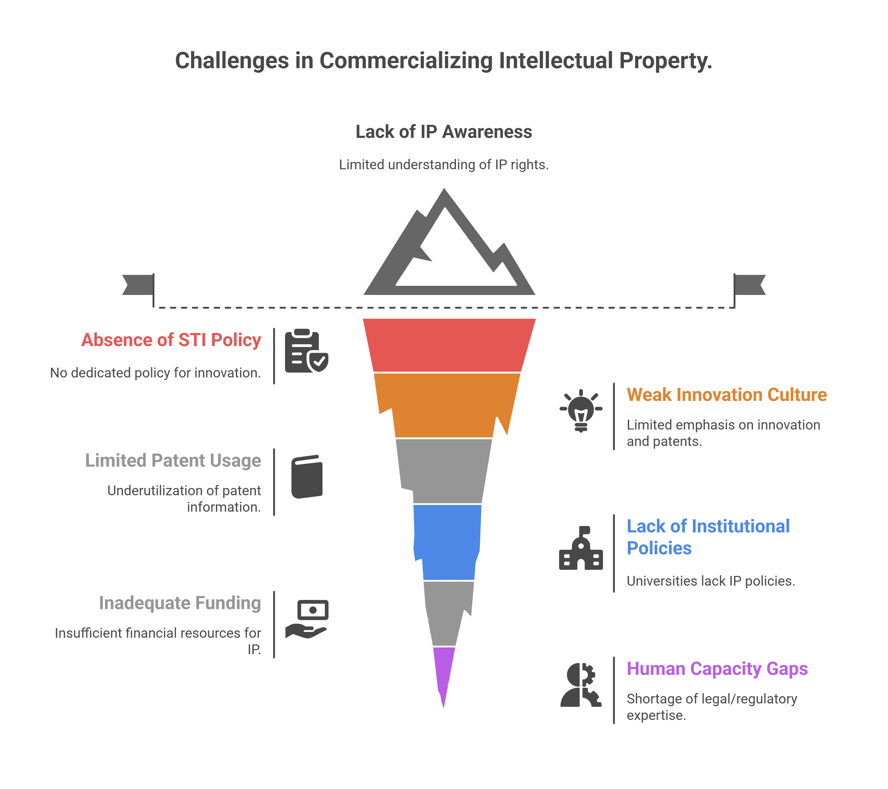

Slide 8
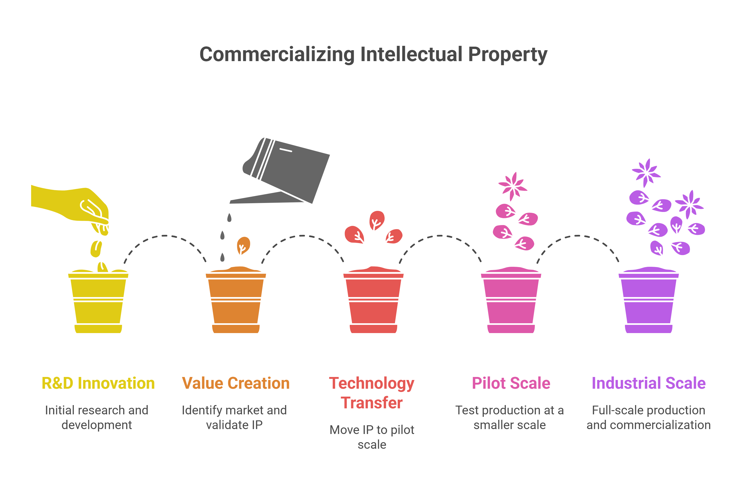

Slide 9
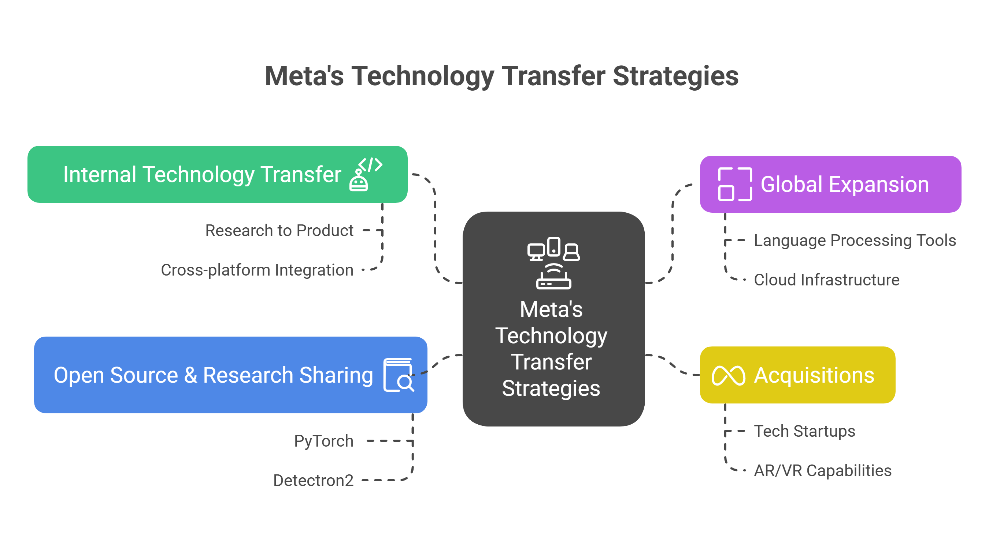

Slide 10
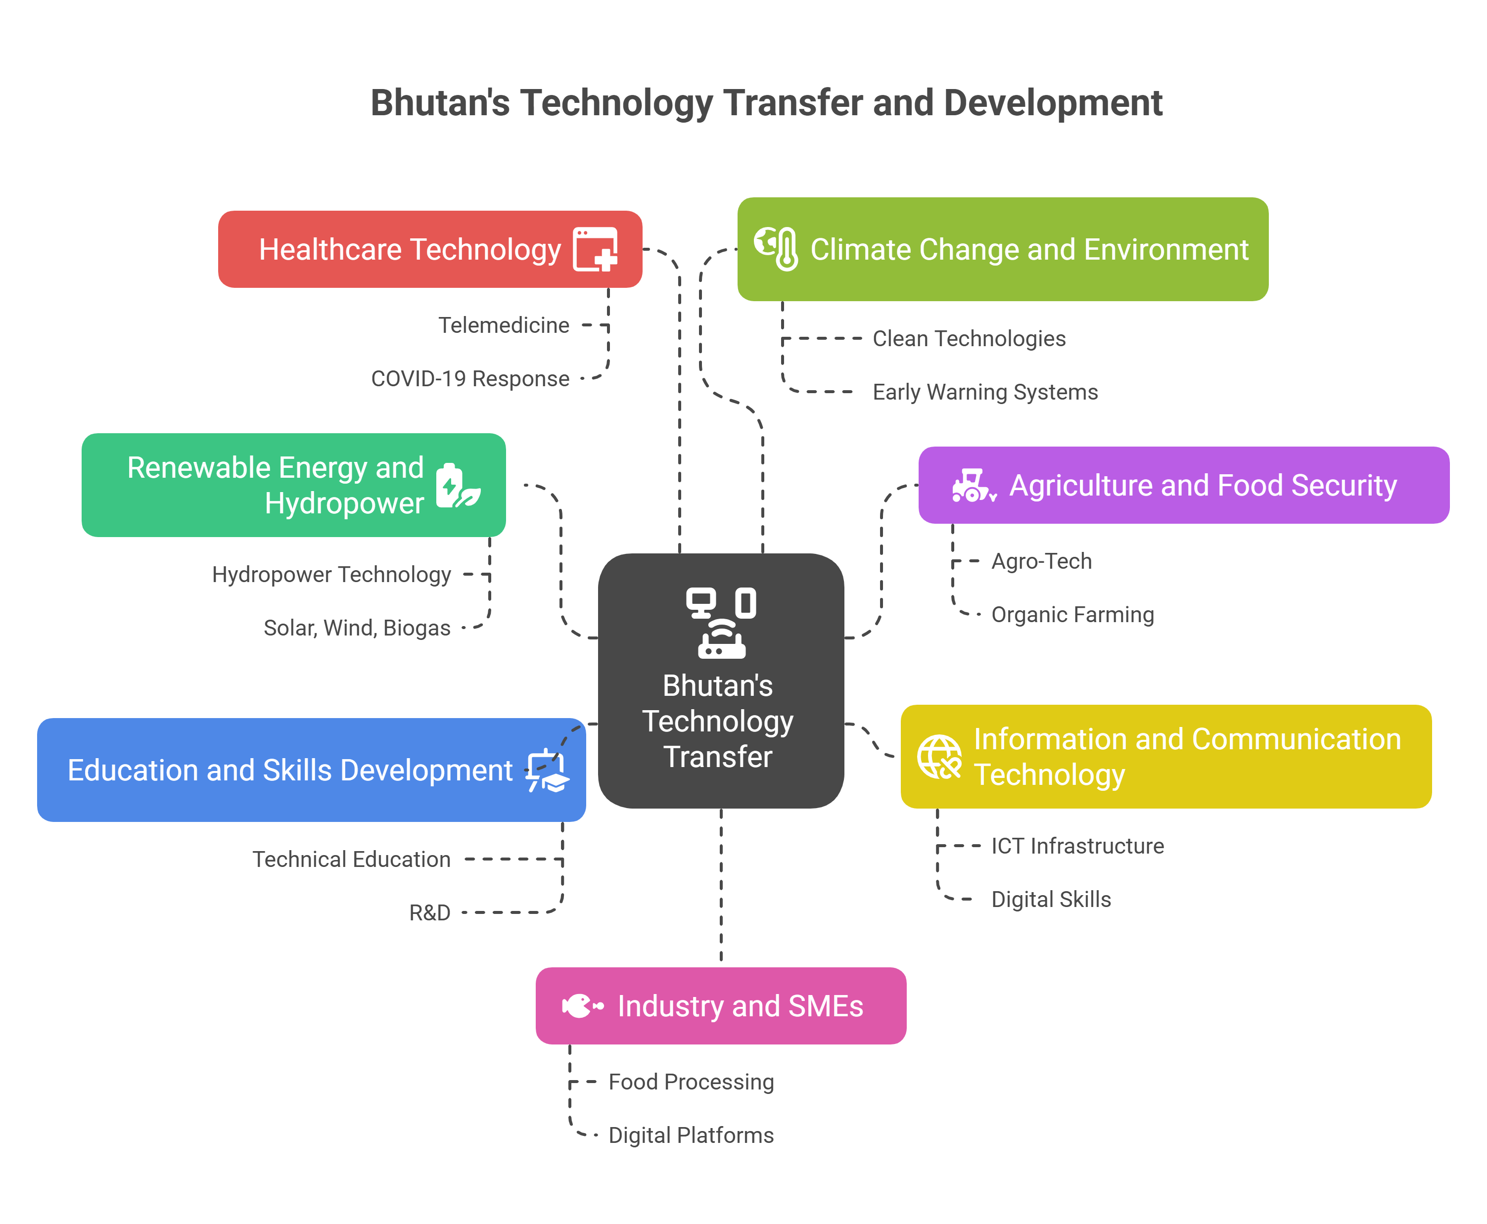

Slide 11
Short reflective assignment
Choose one IT technology Bhutan needs to adopt or develop and analyze how technology transfer should happen, include challenges and recommendations.

Slide 12
REFERENCES
Copyright Act of Kingdom of Bhutan 2001.
Industrial Property Act of Kingdom of Bhutan 2001.
Industrial Property Rules 2001.
National Intellectual Property Policy 2018
Zhib’thsol:RUB Research Policies and Guidelines 2024"
Department of Media, Creative Industry & Intellectual Property | MoICE | བཟོ་གྲྭ་ཚོང་འབྲེེལ་དང་ལཱ་གཡོག་ལྷན་ཁག།
Cottage-Small-Industry-Policy-2019
GovTech Digital Strategy 2024.
Policy and Planning Division, Ministry of Education, & Tertiary Education Division, Department of Adult and Higher Education, Ministry of Education. (2017). Bhutan Tertiary Education Roadmap 2017-2027

Slide 13
THANK YOU

